Slide 1
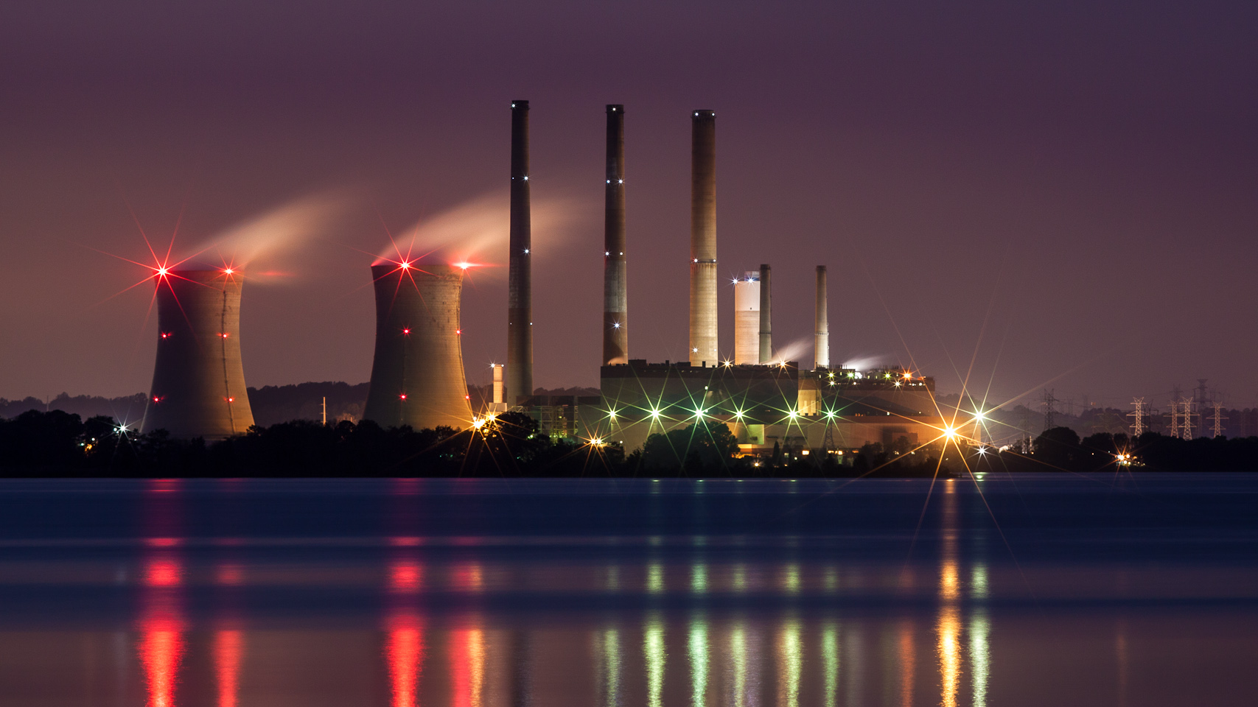

Indian Power Sector at a Glance
Indian Institute of Technology Guwahati
Data Visualization for Indian 'State-wise Installed Power Capacity Data' and 'Regional Grid-wise Power Generation Data' across different sources of energy.
Nikhil Thosar (224161020)
n.thosar@iitg.ac.in
Course: CS595
Course Instructor: Dr. Ashish Anand

Slide 2
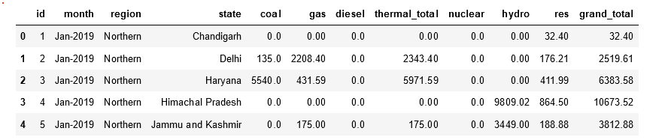
Data Description and Analysis:
Data File: Installed_Power_Capacity_State_wise_MW.csv
Details: The given data represents the monthly electricity generation and distribution statistics for the five regions of India from Jan-2019 to Jan-2022 The data is broken down by state and includes information on the amount of installed electricity generation capacity using different sources such as coal, gas, diesel, thermal, nuclear, hydro, and renewable energy (RES) and the total installed capacity by each state.

Slide 3
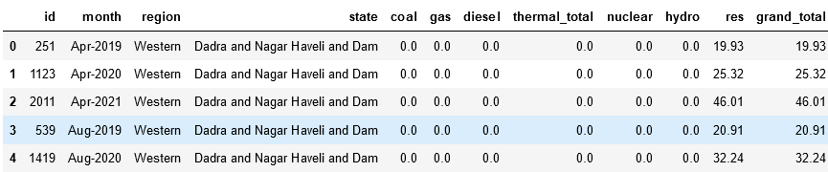
Data Anomalies:
In original data, for state 'Andhra Pradesh' , for certain data entries state-name was 'Andhra Pradesh.', during data cleaning, I replaced it appropriately.
From 26th January 2020, 'Dadra Nagar Haveli' and 'Daman-Diu' merged to a single Union Territory so data inconsistency and discontinuity was there, as data for same state was present with three different names and for different time periods. I removed this inconsistency and discontinuity that could have lead to complicate visualizations for user.

Slide 4
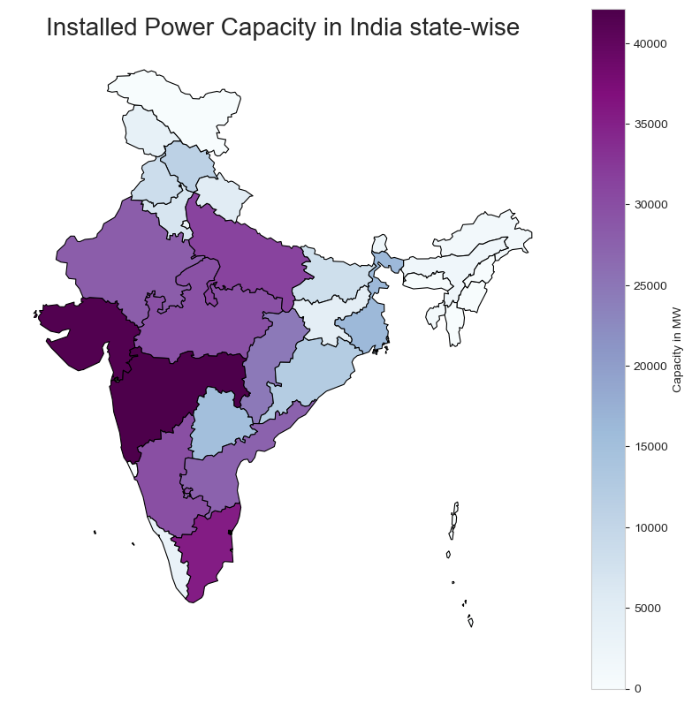
PLOT I: Choropleth Map of India for Summarizing the Indian Power Sector
Plot Description:
This is geographical plot, called ‘Choropleth Map’, I plotted using ‘Geopandas’ library.
This is used to show overall summary of Indian Power Sector at particular time point.
Unit of installed capacities is MW.
State-wise comparative study can be done through this plot and overall idea can be gained.
Observations:
Highest Total Installed Capacity States – Maharashtra, Gujarat, Tamil Nadu.
Most Developed Power Infrastructure is in Western Region.
Region lagging behind in Power Infrastructure is Eastern Region

Slide 5
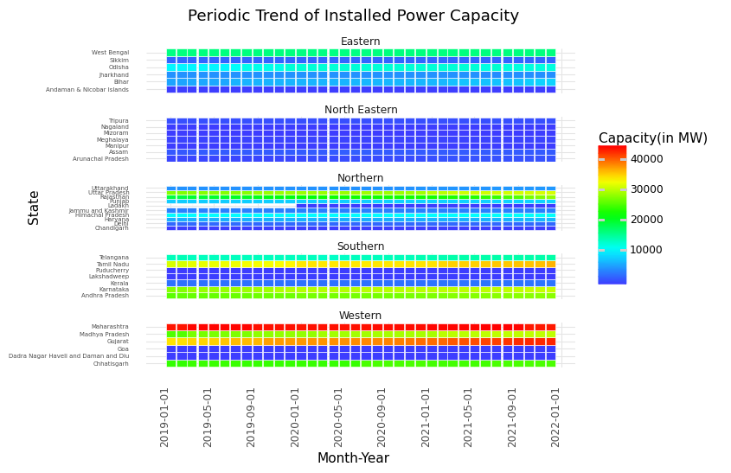
PLOT II: Periodic Heat Map State-wise with Region-Wise facets
Plot Description:
I have plotted this facetted heat-map for installed capacity data.
This is periodic plot, showing the trend of power generation capacity of states individually and facet comparison can give you idea about the region wise infrastructure development.
Observations:
Maharashtra is having consistently the highest installed capacity through out the years.
Gujarat showed steepest increase in power infrastructure, followed by Tamil Nadu and Rajasthan

Slide 6
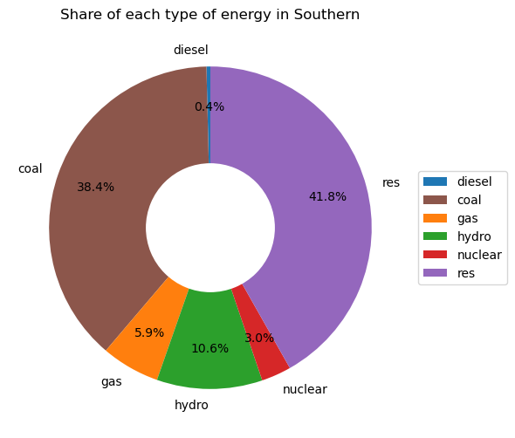
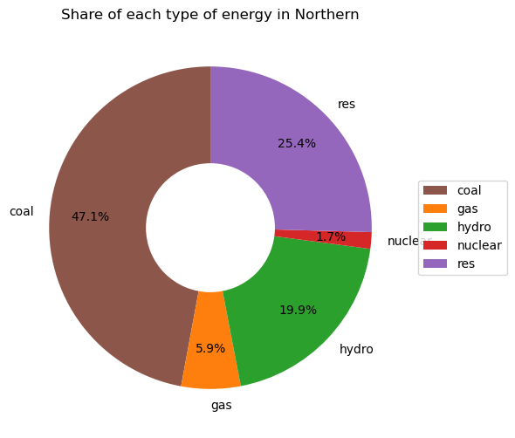
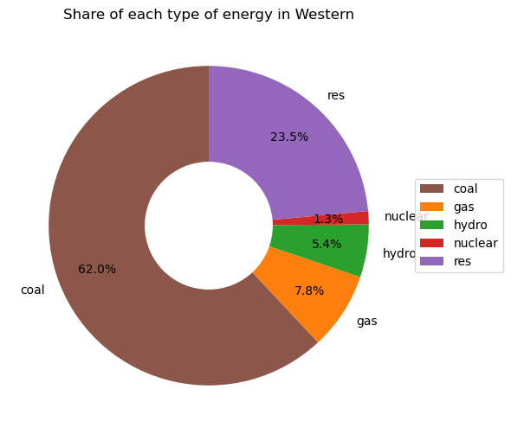
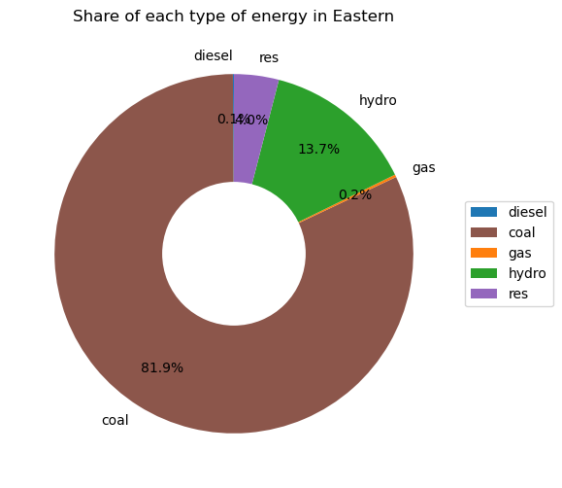
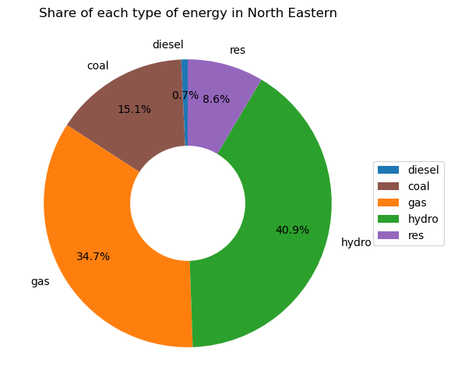
PLOT III: Different Energy Sources Distribution
Details: Capacity installed during the given period can be seen from below visualizations and the highest three states having maximum capacity installed during this period are highlighted with different color.

Slide 7
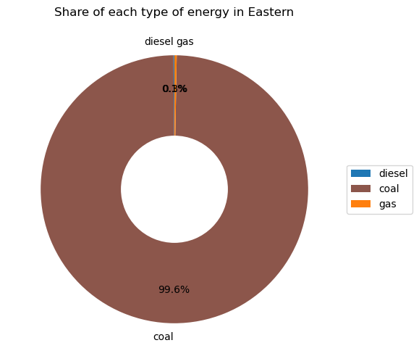
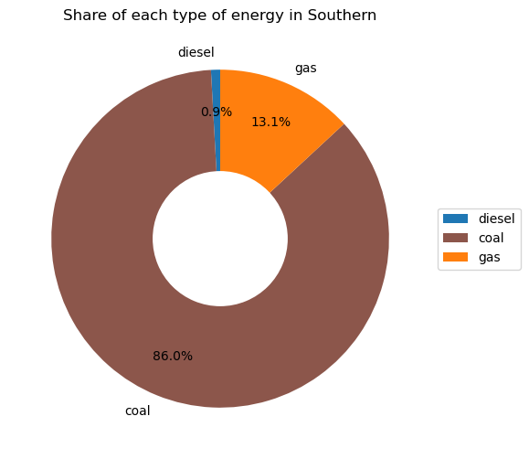
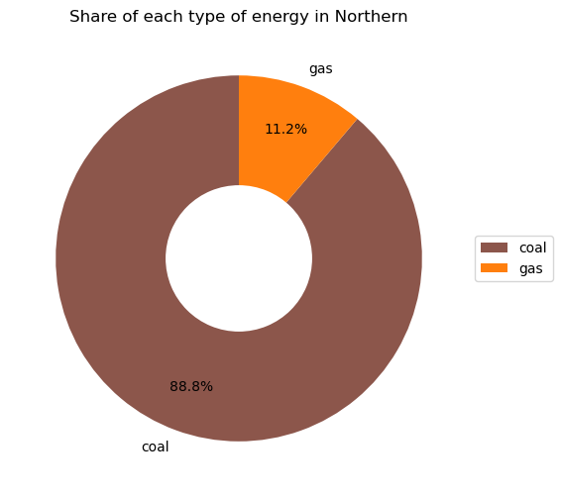

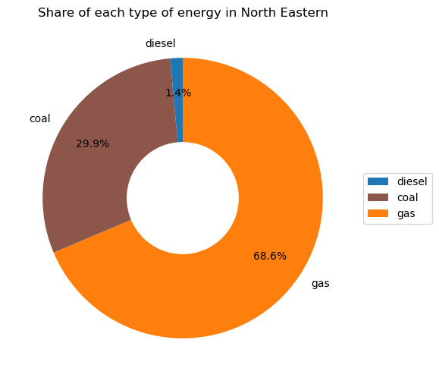
PLOT IV: Different Thermal Energy Distribution
Details: Capacity installed during the given period can be seen from below visualizations and the highest three states having maximum capacity installed during this period are highlighted with different color.

Slide 8
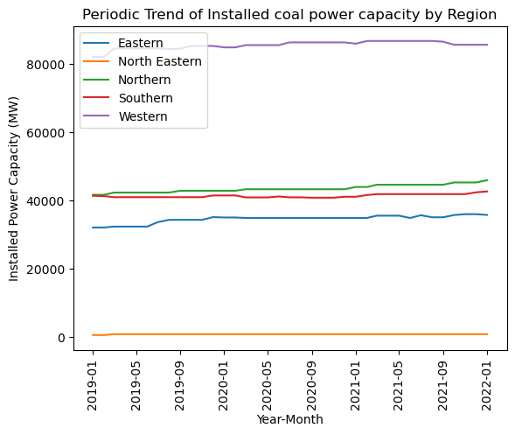
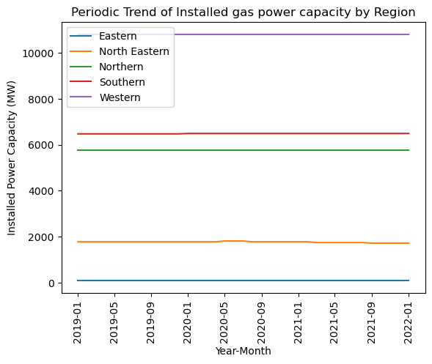
Plot V: Coal and Gas Power Capacity Periodic trend over the period of 2019-2022

Slide 9
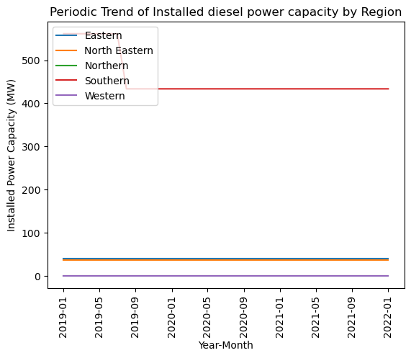
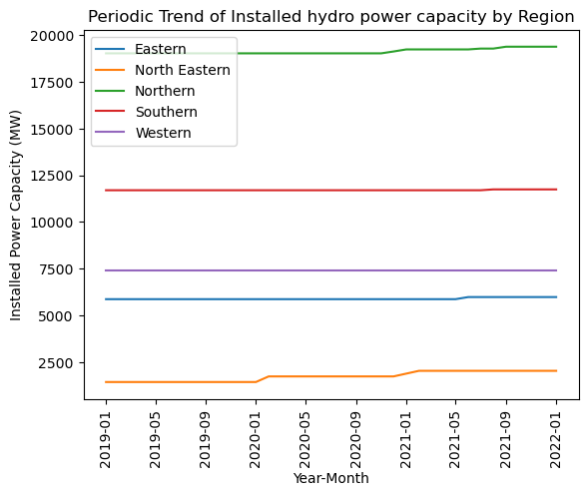
Diesel and Hydro Power Capacity Periodic trend over the period of 2019-2022

Slide 10
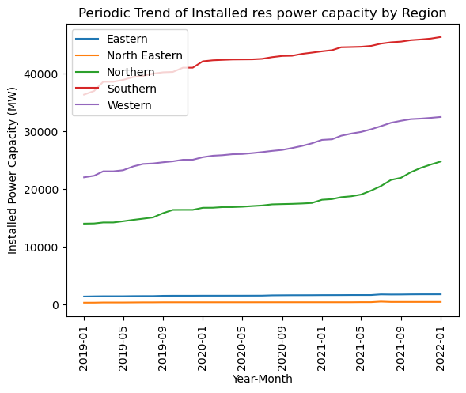
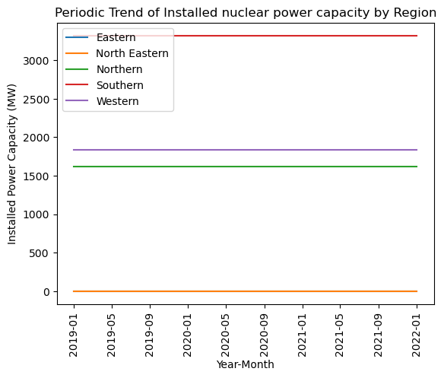
Renewable and Nuclear Power Capacity Periodic trend over the period of 2019-2022

Slide 11
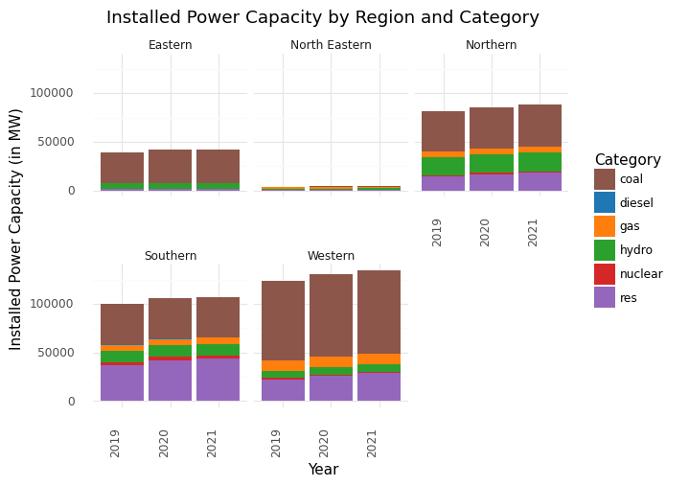
PLOT VI: Region-Wise Facetted Stacked Bar Plot for 2019-2022
Details: Five facets each of a particular region makes it easy to compare data of installed capacity for period, moreover for different sources of energy gives idea that coal plants are the most dominant source of power generation facility installed in most of the regions.

Slide 12
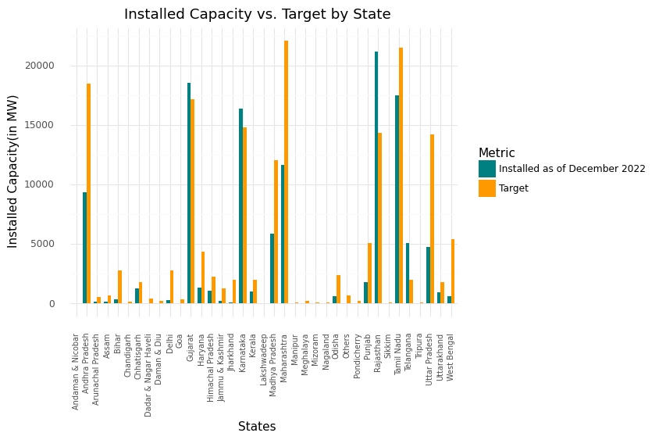
Plot VII: Renewable Installed Capacity Vs Development Target for States
Plot Description:
1. This bar plot is showing two statistical figures for each state, one is Installed Capacity as of December 2022 and Target.
Observations:
1. Few states are showing and extraordinary work in renewable power sector, e.g. Karnataka, Gujarat, Telangana. They surpassed the target given to them for developing power infrastructure.

Slide 13
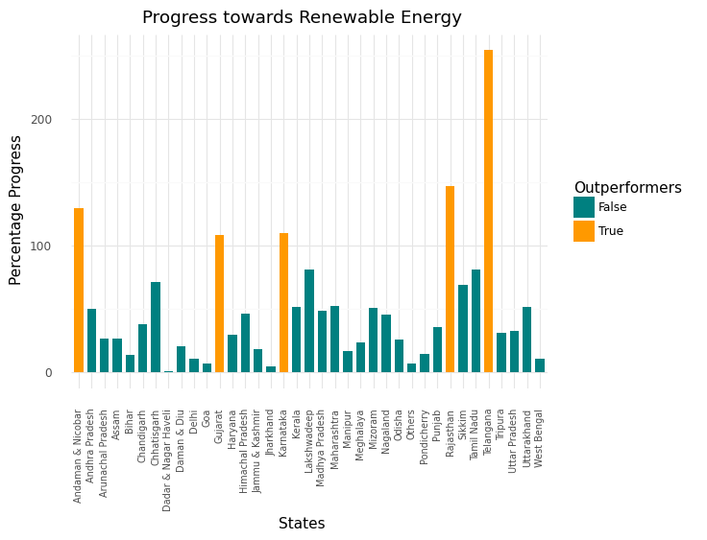
PLOT VIII : Bar Plots for Percentage Progress by States
Plot Description:
This bar plot showing what percent of work is completed by every state in w.r.t Renewable energy Target given by administration.
Gujarat, Karnataka, Rajasthan Andaman and Nicobar have surpassed the mark of 100%.
Interesting insight that can be seen from this plot is the tallest orange bar of Telangana, it showed 254% progress, which is significantly high compared to other states.

Slide 14
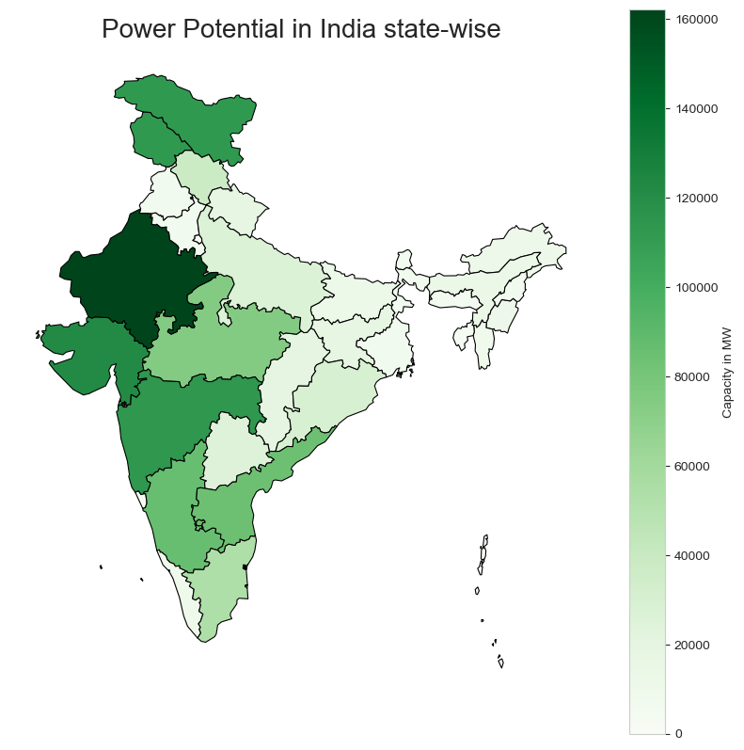
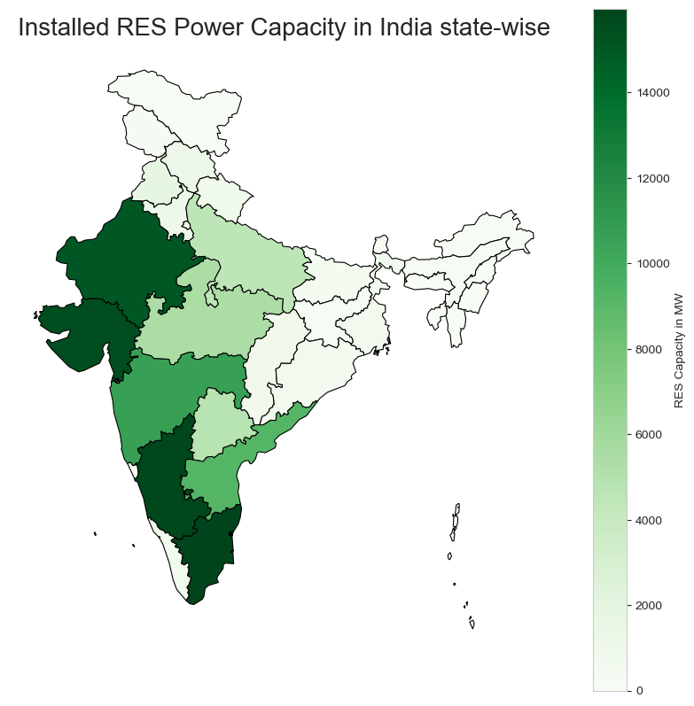
Plot IX: Choropleth Maps: Potential of States compared with Current Installed Capacity

Slide 15
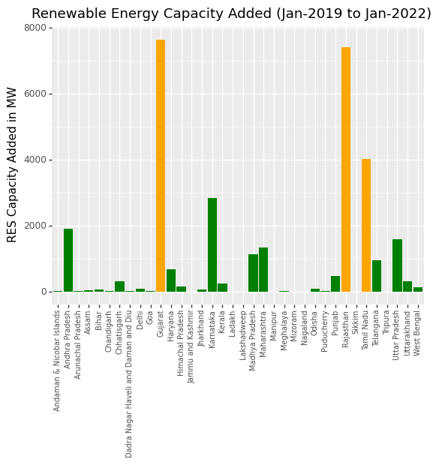
PLOT X: Renewable Energy Plots
Details: Capacity installed during the given period can be seen from below visualizations and the highest three states having maximum capacity installed during this period are highlighted with different color.

Slide 16
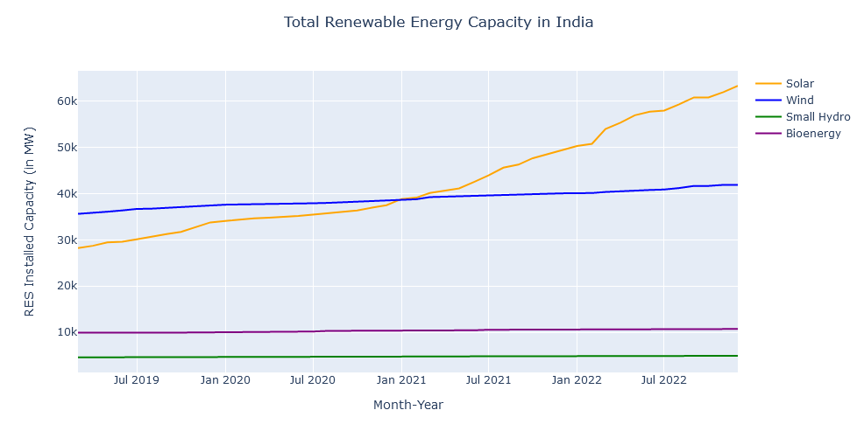
PLOT XI: Further Categorization in Renewable Energy Generation: [Solar-Wind-Small Hydro-BioEnergy]

Slide 17
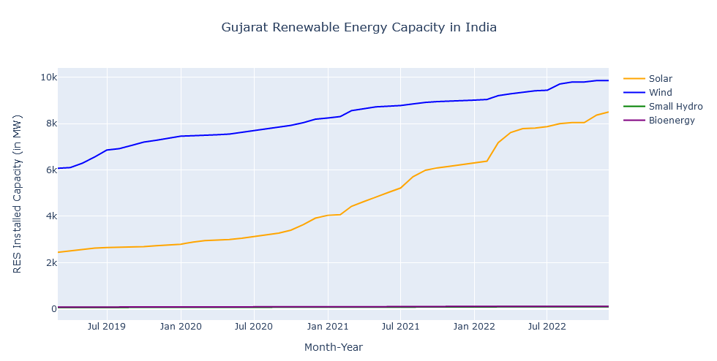
Gujarat Categorization in Renewable Energy Generation: [Solar-Wind-Small Hydro-BioEnergy]

Slide 18
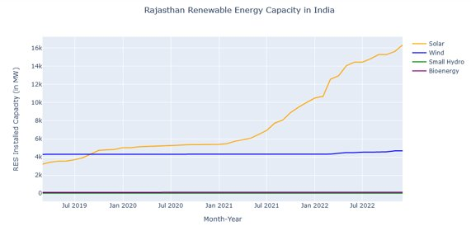
Rajasthan Categorization in Renewable Energy Generation: [Solar-Wind-Small Hydro-BioEnergy]

Slide 19
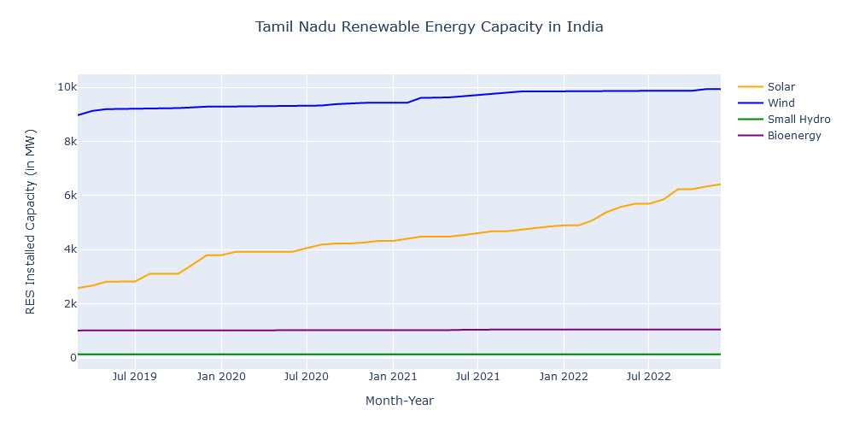
Tamil Nadu Categorization in Renewable Energy Generation: [Solar-Wind-Small Hydro-BioEnergy]

Slide 20
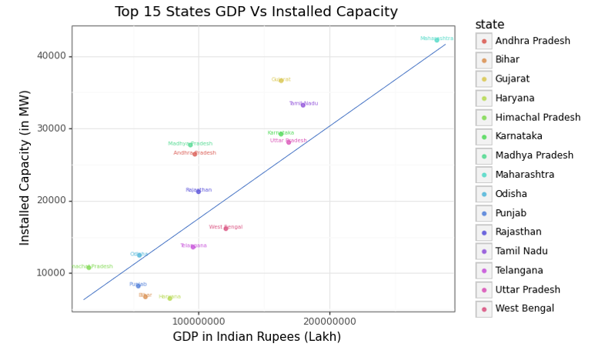
PLOT XII: Scatter Plot showing correlation between GDP and Power Infrastructure in States

Slide 21
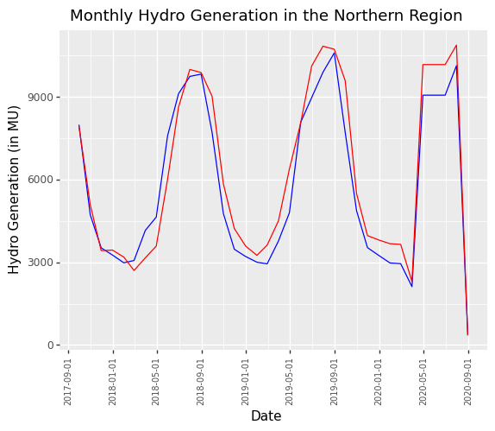
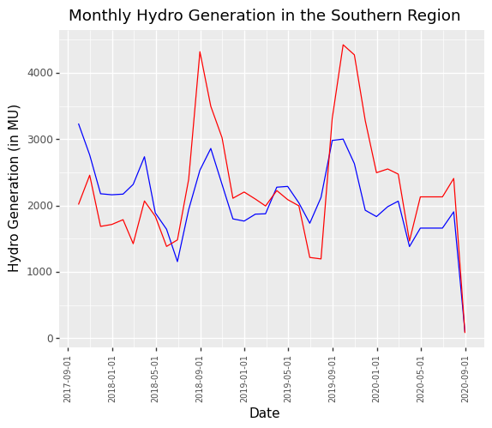
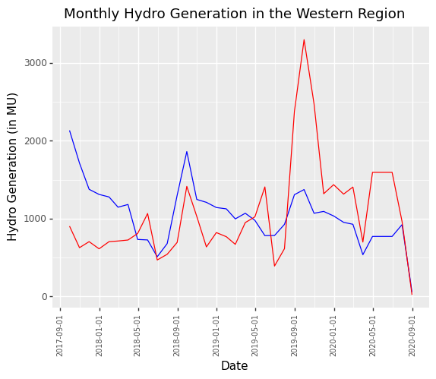
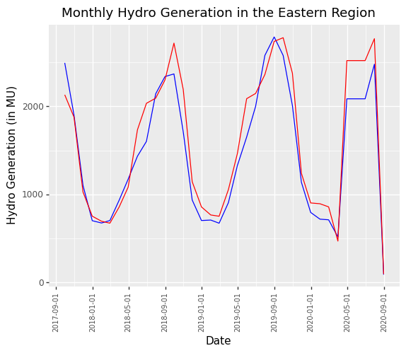
PLOT XIII: Line Plots for Nature of Hydro Power Generation throughout Year
1. Spikes in hydro energy generation can be observed in month of September-October.

Slide 22
THANK YOU!

